Slide 1
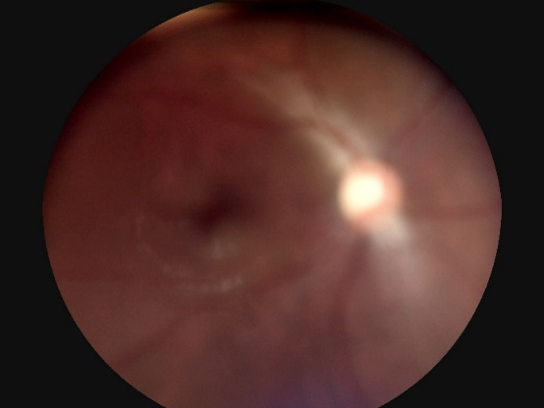
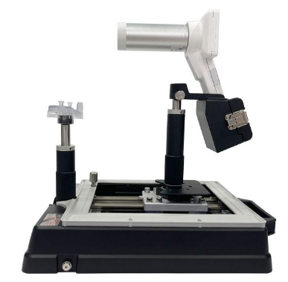
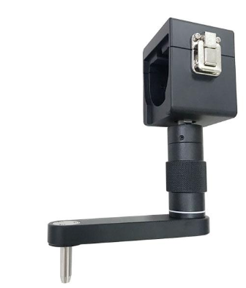
How To Take Great Photos-5
Issue: The image is complete but blurry.
Root Cause：The distance and angle between lens and patient's eye are almost correct, but camera or patient doesn't stay stable during photographing.
Solution：Keep camera and patient's eyes steady during photographing.
PS. The Horus fundus camera can be used with a dedicated jig or portable chin rest (CR100).
Dedicated JIG
Portable Chin Rest
(CR 100)

